Slide 1


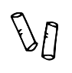


Data Science in Context Presentation
Seung Min Song
Table of contents:
1. What is CRM
2. How to do business with CRM
3. Relationships
4. How to Use CRM
5. CRM Tools
6. Why data scientist is needed for CRM development

Slide 2
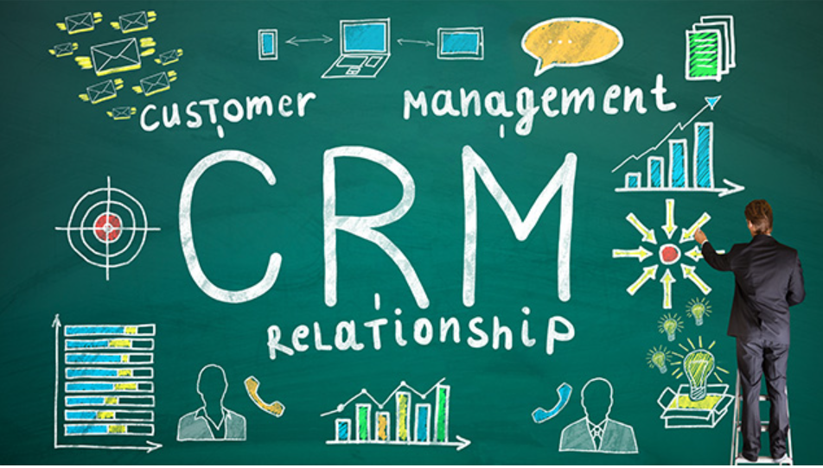

What is CRM
CRM:
CRM stands for 「Customer Relationship Management」. It is a concept to improve customer lifetime value (LTV) by maintaining a good relationship based on marketing activities tailored to the customer's point of view and in charge of communication with customers. The systems and tools used for this purpose were called CRM systems and CRM tools, but now it is common to call them CRM including tools.

Slide 3

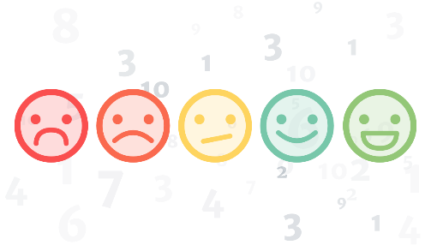
How to do business with CRM?
So what specifically can you do with CRM? In a nutshell, it means "recording, analyzing, and utilizing communication with customers". For example, if you organically collect customer information such as “when, who, what, how much” and the history of inquiries, requests, and claims from those customers in one place, you can respond based on the circumstances so far, so you can build customer trust. You can increase it.

Slide 4
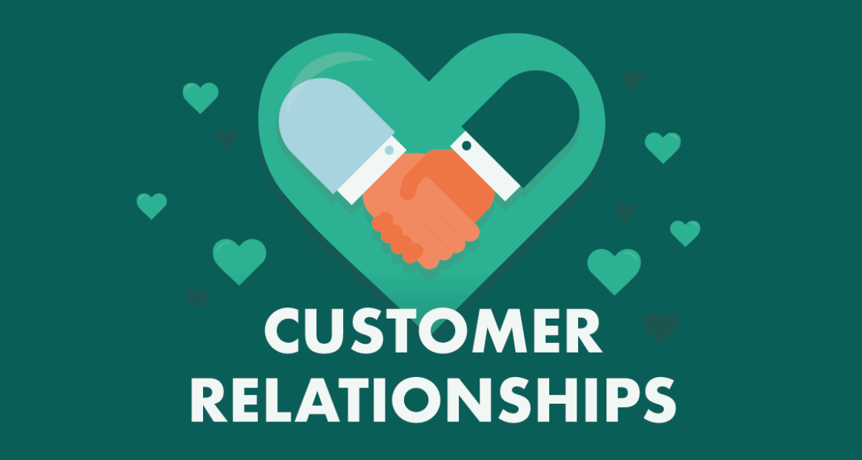
Customer Relationships
CRM is one of the customer management tools for “managing relationships with customers”. For this, CRM makes it possible to accumulate and manage customer information and communication history with customers over time. The accumulated information can be updated and shared in real-time within the team, and it is also possible to extract and analyze it based on various criteria. A tool that derives the best action based on the relationship with the current customer based on a vast amount of information. That is the essence of CRM.

Slide 5


How to Use CRM?
Draw a vision
CRM isn't really a tool, it's a sales method itself. That's why it's important to have a clear vision and sales strategy in place before adopting a tool. The point is to develop sales activities according to that strategy and use CRM tools proficiently in the process. The first thing to do to do this is to establish a vision. Depending on the company, there will be various visions such as “to become the top regional sales leader” and “to provide new value to customers”. To put it simply, a vision that all members can understand and empathize with is good.
Build your strategy
Once you have a vision, you need to build a strategy to make it happen. What value can be provided to customers by utilizing the features and characteristics of the company or its products, there will be price or function, uniqueness, solid customer support system, points for sales, etc. It would be great if you could build a strategy to make the most of it. Vision and strategy are very important in order to avoid failure in CRM adoption.

Slide 6


How to Use CRM?
cont'd
Set Goals
Once you have established your vision and strategy, set it as a goal for your day-to-day work. And, to achieve that goal, we determine what information should be accumulated and utilized in the CRM.
Setting Evaluation Indicators
To evaluate an action, you must measure its outcome. CRM makes it possible to quantify and examine a lot of information, and furthermore, it is possible to verify information that cannot be quantified, such as the contents of customer consultations and their histories, over time.

Slide 7
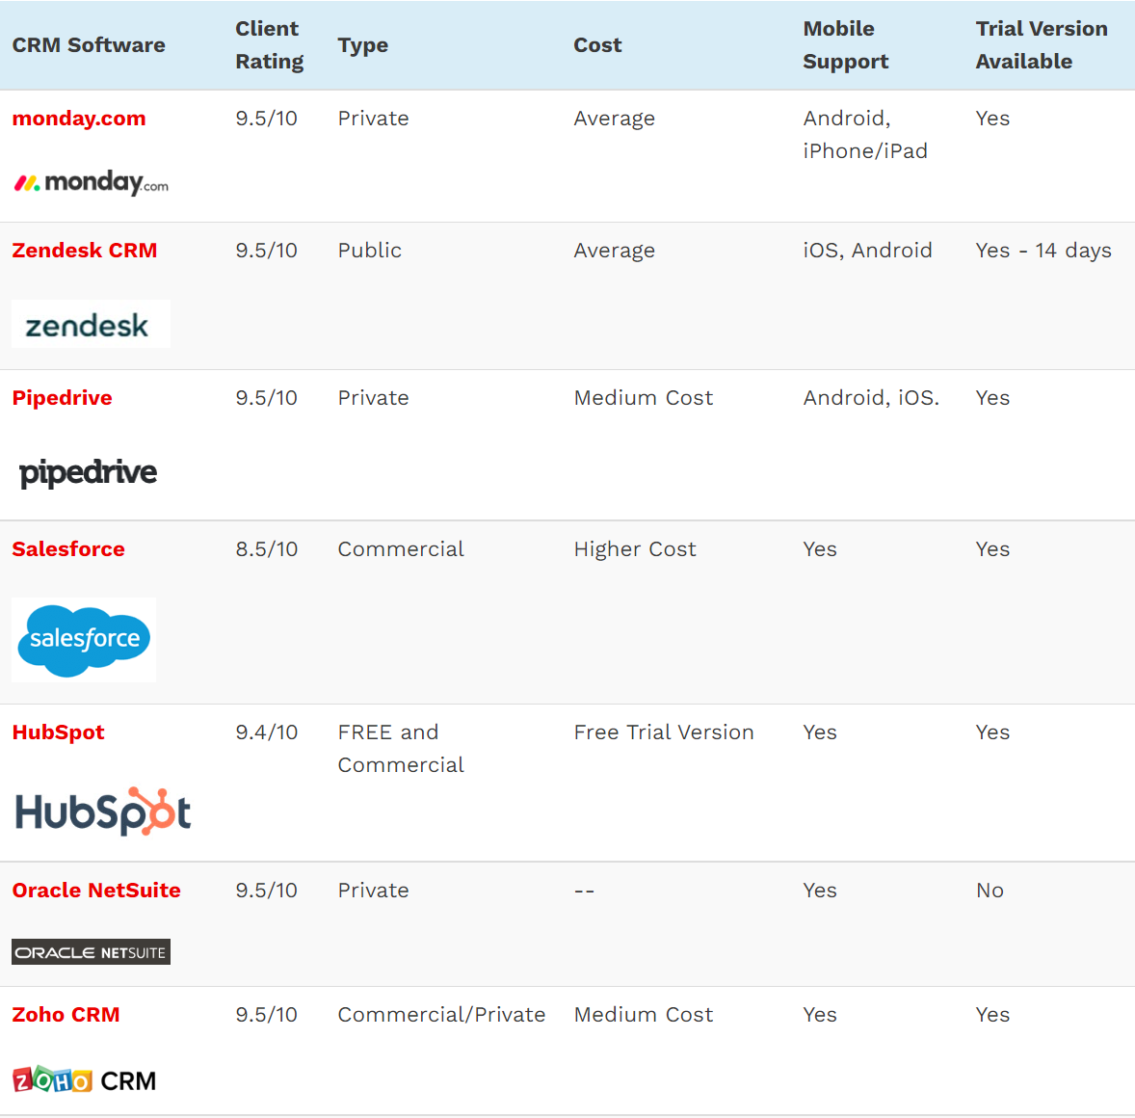
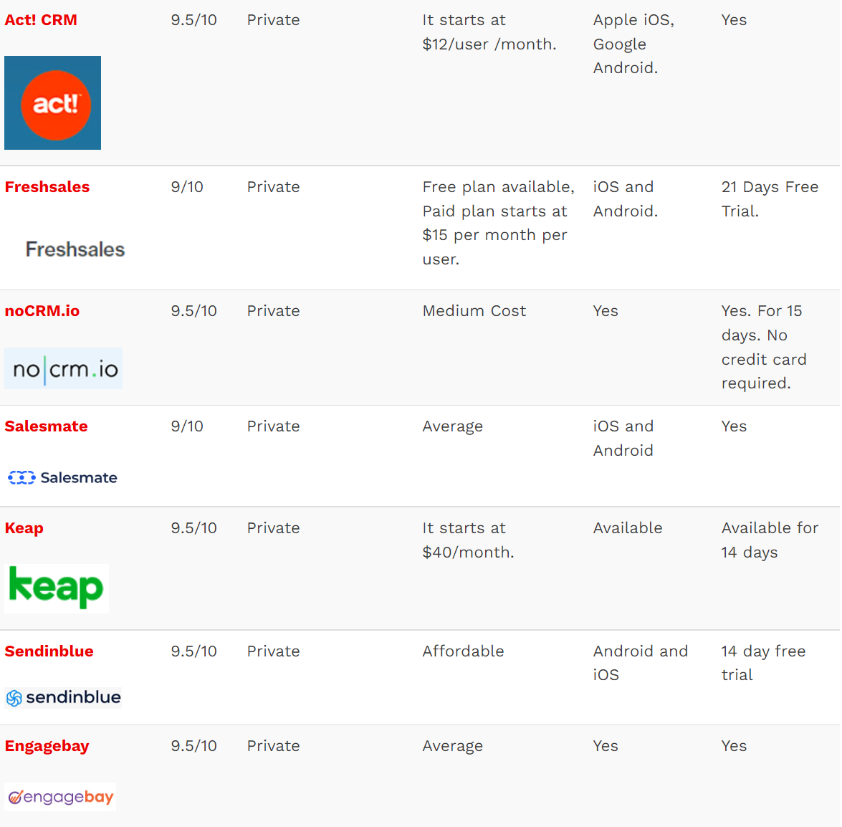
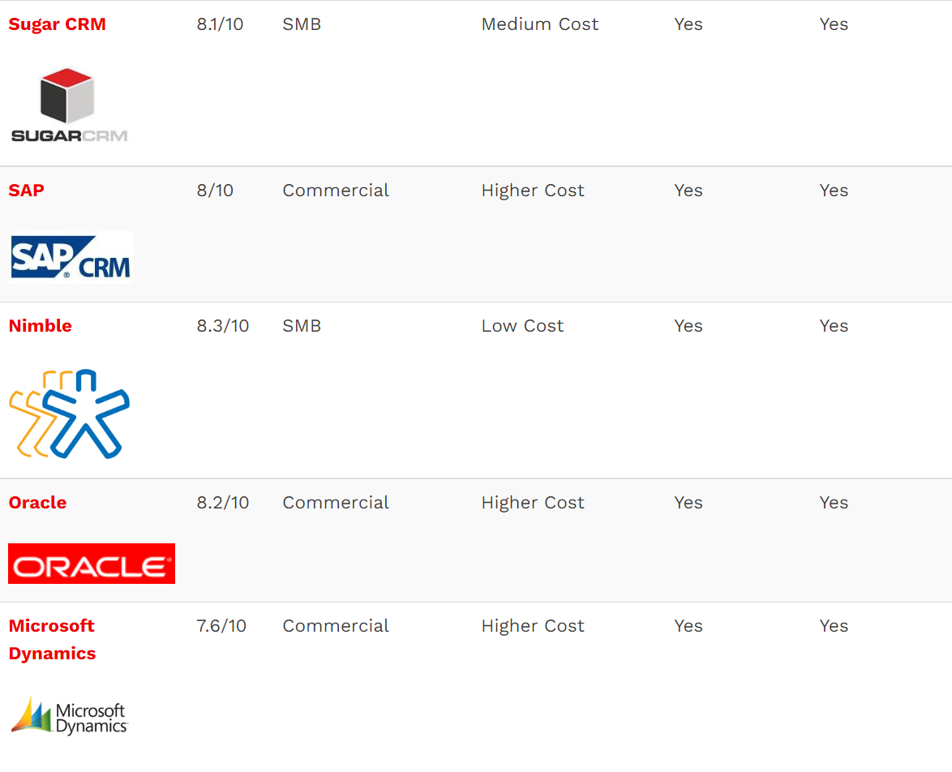
CRM Tools?

Slide 8
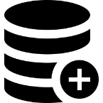





CRM Tools?
cont'd
Customer DB Management
Integrated Work Management
Check whether integrated work management is possible by supporting interworking with external software.
Pipeline Management Capabilities
The pipeline feature allows you to prioritize based on criteria and focus on prospects who are most likely to convert into customers.
Time Management and Scheduling
Workflow management function.
Sales Automation
Manage the sales cycle, automatically assign sales reps, or send notifications to sales reps.
Email Marketing Automation
Whether you're sending out an email to a new lead or sending a marketing promotion email to an existing customer, your CRM process is sending automated emails in a variety of ways.

Slide 9



Data Scientist
Determines the buying trends from the purchase history, Improves your sales conversion numbers, Enhances customer satisfaction, Drives high customer retention rates, and Boost profits.
Sentiment Analysis- analyze the conversation and assess the
emotional levels

